Slide 1


Slide 2

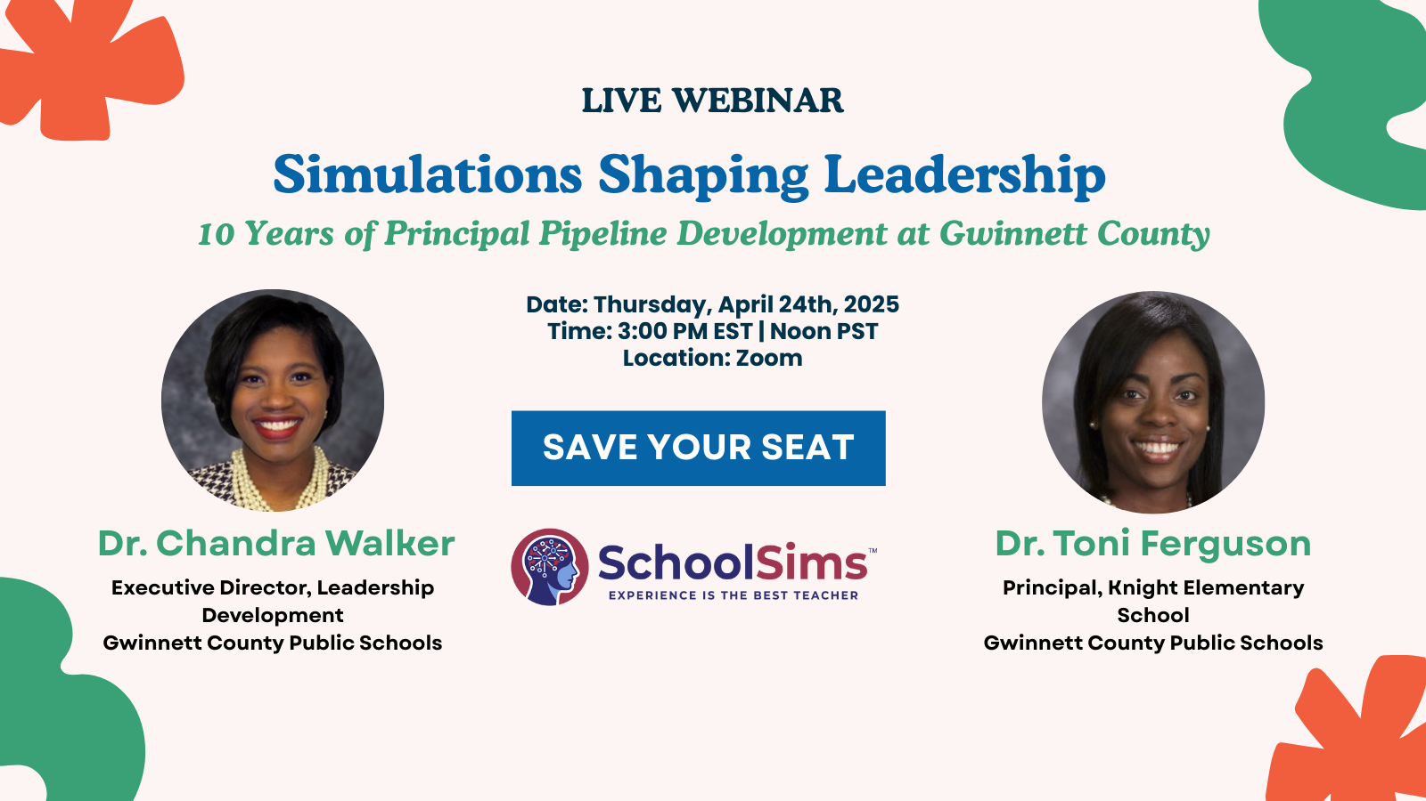

Slide 3
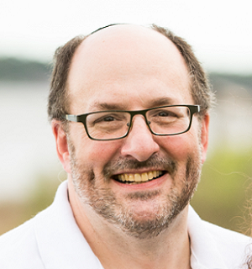

Ken Spero
President & Co-Founder
kspero@schoolsims.com
For over 30 years, Ken has leveraged simulation-based learning to help professionals develop critical decision-making skills in a risk-free environment. In 2008, he recognized an opportunity to apply this approach to K-12 leadership, addressing the high turnover of educational leaders and its impact on schools. By capturing real-world experiences and transforming them into interactive simulations, he created a way for school administrators to practice navigating complex challenges, balancing trade-offs, and experiencing consequences before facing them in real life. For the past 10 years, he has been focused on the Silent Crisis of Leadership in K-12, working to strengthen leadership capacity and critical thinking among school leaders.
Additional SchoolSims Resources
Preview the SchoolSims Library
This page offers interactive simulations that let educators and school leaders practice decision-making, navigate challenges, and refine their leadership skills.
Programs
This page features simulation-based programs that help educators and school leaders build essential skills. Programs cover teacher induction, leadership development, culturally responsive training, and professional learning for independent schools.
Downloadable Resources
This page provides downloadable resources to help educators and school leaders use simulations for professional development. Materials include guides, reports, and simulation overviews.
Client Success Stories & Testimonials
This page features testimonials from educators and institutions who have successfully integrated SchoolSims simulations into their programs. They highlight how these interactive tools enhance leadership development, decision-making, and real-world preparedness in educational settings.
Simulation-Based Research
This page highlights research on simulation-based learning in education, showcasing studies on its impact, applications, and benefits for educators and leaders.

Slide 4


Simulation-Based Experiential Learning
Practice Critical
Decision-Making in
a Safe Environment
SchoolSims transforms K-12 professional development and higher education curriculums through simulation-based experiential learning. These choose-your-own-adventure simulations immerse participants in realistic scenarios, offering 6-8 critical decision points that seamlessly bridge the gap between theory and practice. By experiencing the immediate and long-term consequences of their decisions, users develop deeper insights, enhanced problem-solving skills, and stronger leadership capabilities, connecting learning directly to real-world applications in educational leadership.

Slide 5




How Can SchoolSims Be Used?
Synchronously
Asynchronously
In-Person
Video Conference
SchoolSims is a flexible educational tool designed to enhance decision-making and leadership skills across diverse learning environments. It can be used synchronously in live classroom settings, asynchronously for self-paced learning, during in-person workshops, or through video conferencing. No matter the setting, SchoolSims empowers educators and learners with practical experiences, preparing them to address real-world challenges in educational leadership.

Slide 6

Simulation Topics and Titles
Simulation Topics
LeaderSims
TeacherSims
CounselorSims
  Leadership Skills and Development
  Diversity, Equity, and Inclusion (DEI)
  Budgeting and Resource Allocation
  Teacher Evaluation and Development
  Classroom Management Strategies
  Building Inclusive Classrooms
  Special Education and IEP Facilitation
  Parent-Teacher and Stakeholder Communication
  Student Support and Crisis Management
  School Safety and Counseling Programs
  Synergistic Leadership
  Uncovering Hidden Inequity
  Navigating the Politics of Equity-Based Budgeting
  Cultural Competency
  Middle School Turnaround (Implementing Change)
  Value-Based Leadership
  Emerging Challenges of Distributed Leadership
  Managing Diversity in a Growing Community
  Middle School Budget Challenge
  Administrator: First Week on the Job
  Disruptive Teacher
  New Teacher Evaluation
  Academic Goal Setting
  Difficult Conversation: Race
  Building Inclusive Classrooms: Affirming Diverse Families
  Building Inclusive Classrooms: Positive Learning Environment
  Facilitating Alignment (IEP)
  Parent-Teacher Conference
  Special Education: Annual Case Review
  Classroom Challenge: Learning Loss
  Managing Classroom Disruptions
  Star Athlete
  Comprehensive Role of School Counselors
  Virtually Leading a School Counseling Program
  Data Driven Counseling
  School Safety
  Planning for Student Achievement
  Student Support (Transgender)
  Student in Crisis

Slide 7
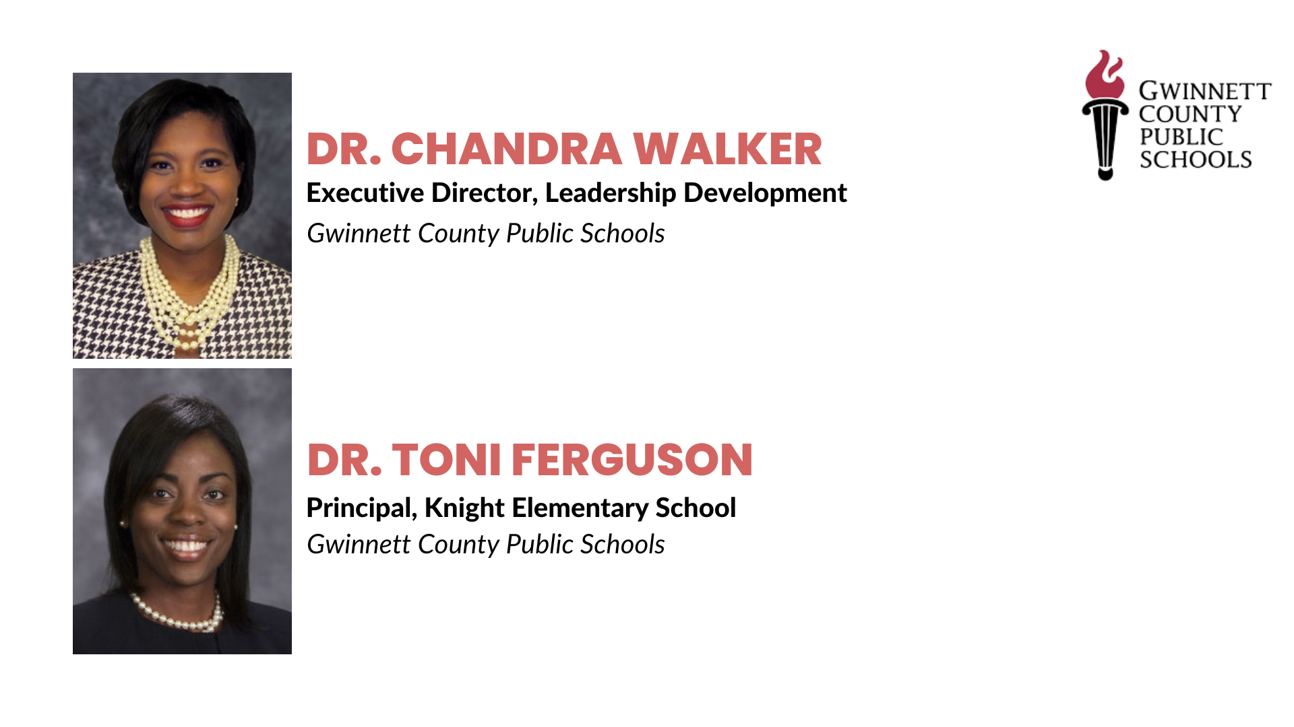
bios

Slide 8
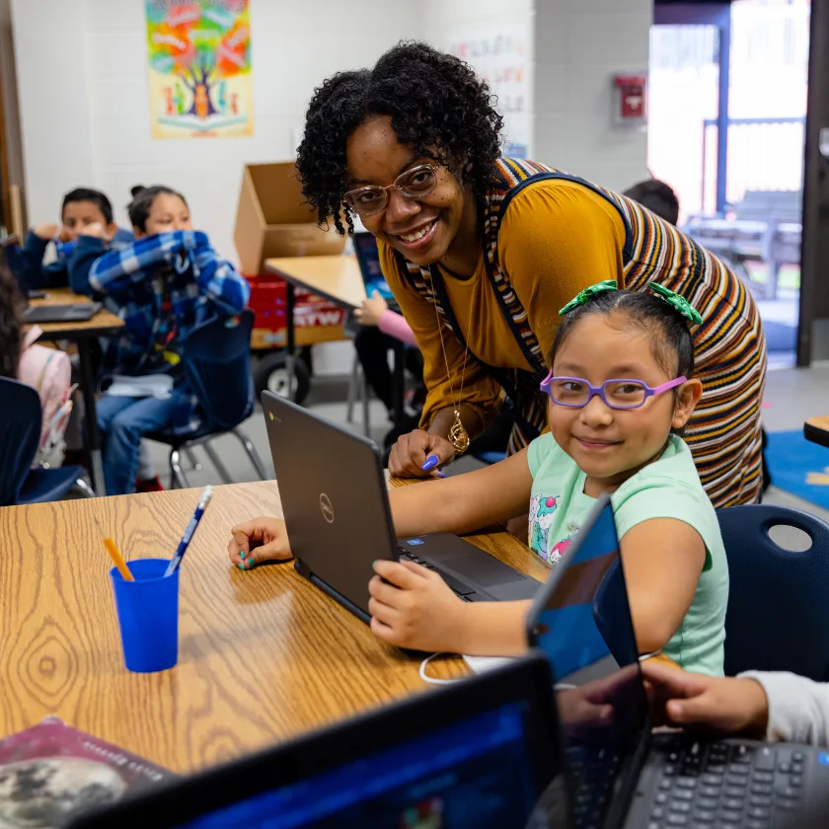

OUR
DISTRICT
Our 142 Schools
81 Elementary Schools
29 Middle Schools
24 High Schools
7 Specialty Schools
1 Charter School
182, 518
students
Our students come from 191 countries and speak 98 different languages.
Racial/Ethnic Distribution
American Indian 2%
Asian/Pacific Islander 12%
Black 31%
Hispanic/Latino 36%
Multiracial 4%
White 15%
GCPS is the largest employer in Gwinnett County and 4th largest in metro Atlanta.
Notes:
Chandra

Slide 9

LEADERSHIP
PIPELINE
ASPIRING LEADER PROGRAM (ALP)
EXECUTIVE COACHING
ASPIRING PRINCIPAL PROGRAM (APP)
LEADERSHIP COACHING
DISTRICT LEADER PROGRAM (DLP)
LEADERSHIP SEMINARS
DISTRICT INSTITUTE FOR LEADERSHIP LEARNING (DILL)
LEADERSHIP SYMPOSIUMS
PROFESSIONAL LEARNING OPPORTUNITIES (PLO)
ASK-THE-EXPERTS
JUST-IN-TIME TRAINING (JIT)
Notes:
Chandra

Slide 10

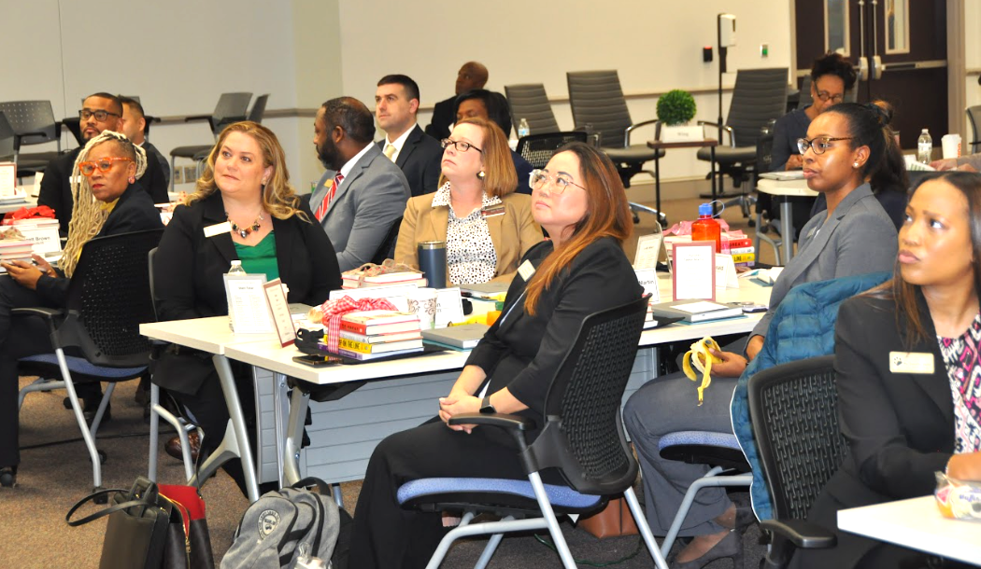



TARGETED PROFESSIONAL LEARNING
Aspiring Principal
Program
Aspiring Leader
Program
Leadership Symposiums
Customized Coaching Support & Onboarding
Notes:
Chandra

Slide 11
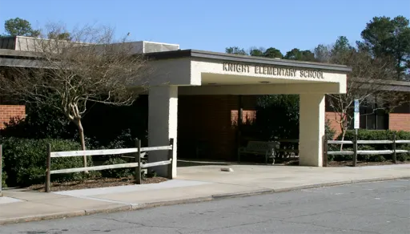
SCHOOL IMPROVEMENT
Supports implementation of school vision and mission
Develops capacity of teacher leaders
Promotes collaboration in investigating problems of practice
Builds coherence in teaching, learning, and leadership expectations
Notes:
Toni

Slide 12
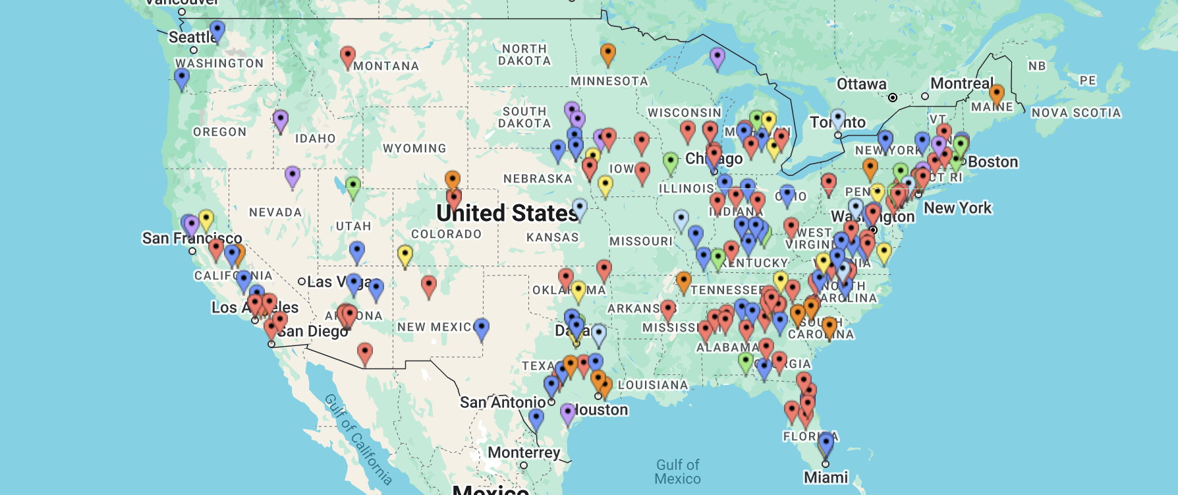
Where Schools Are Using SchoolSims

Slide 13

CTA

Slide 15


